Slide 1


Ninja Turtle Game
Omar Alaaeldein 120180022 Ahmed Elshahat 120180038 Yousef Mohammed 120180002

Slide 2
Process
Choosing Libraries
Used tkinter, turtle, pillow
Creation of Game
Using tkinter to make the interface for the launcher
Algorithm
How the turtles race

Slide 3
Libraries
Tkinter : used to make the launcher gui to represent the game
Turtle : used to make the window of the game with the build of motion for the racers
Pillow: used to integrate pictures with the gui with extra capabilities

Slide 4
Design Patterns
Singleton Design Pattern: it was the parent class for specific classes to inherit
Used in classes ( finish line, Dirt)
OOP is Open for extension and closed for modification

Slide 5
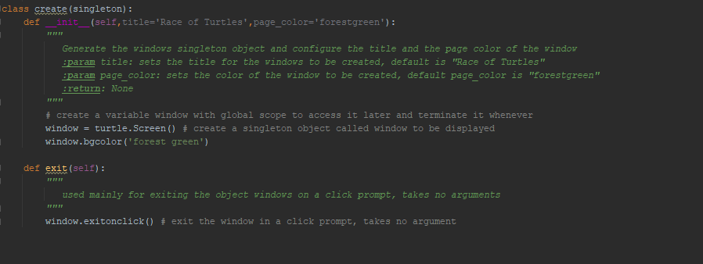
Creation of Window

Slide 6
Shapes
The class is specific to make simple shapes that will be used
Example is the square which will be used for the making of the finish line
Adding more shapes for extra abilities in the game

Slide 7
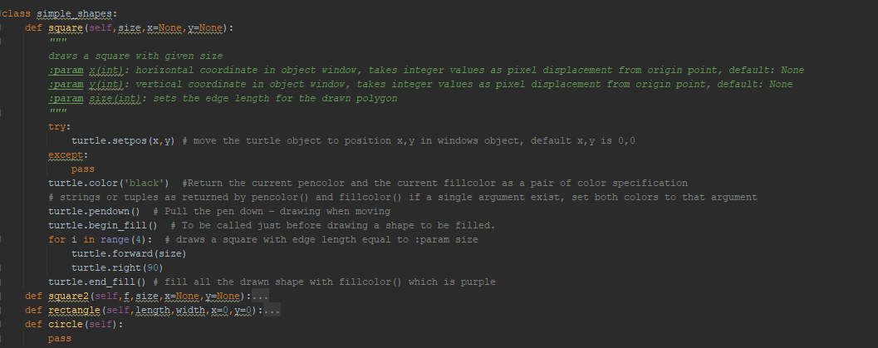
Shapes Class

Slide 8
Finish Line
Finish line consisted of columns
Each column can be done alone
To make the program faster we made it make rows of 3 to make it 3 times faster than the normal way

Slide 9
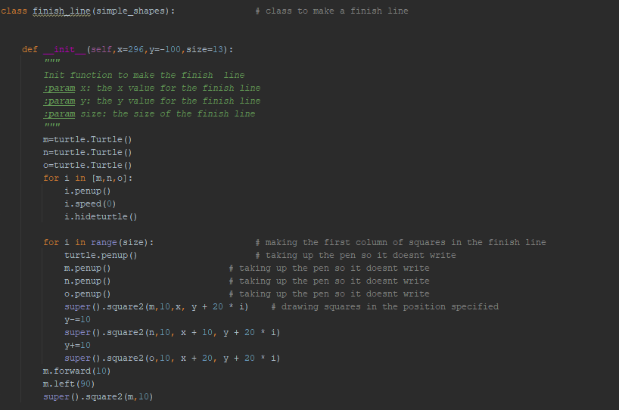

Finish Line Class

Slide 10

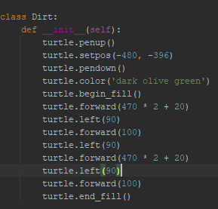
Dirt
It is a class responsible for adding the shape of dirt in the game as an extra feature

Slide 11
Information / Words
We made class named words that is responsible for presenting the information about the game
Information to be presented are
Title of the game
Description about the game

Slide 12
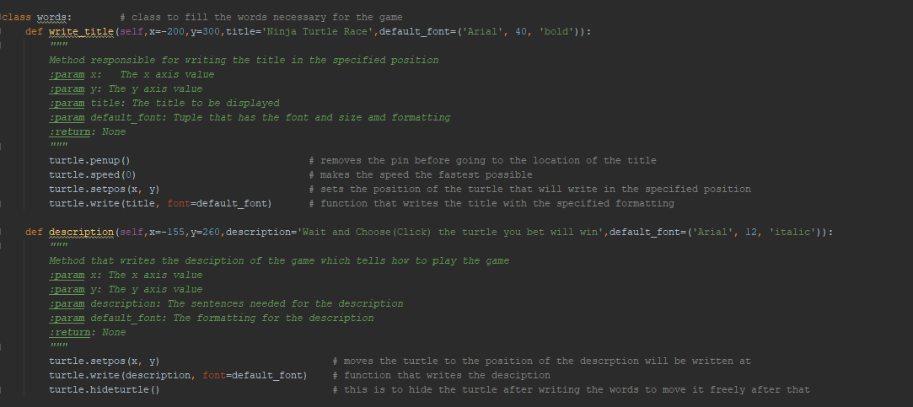
Words Class

Slide 13
Algorithm
The class racers has the main algorithm of the game
First method is the init to initiate the players that will race
Second method move determines the speed and movement of the turtles
Third and Forth method click, play are responsible for taking the click from the user and registering the chosen turtle to race

Slide 14
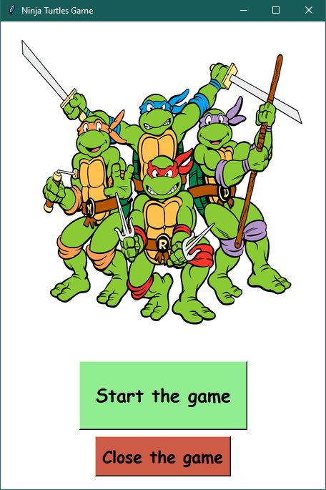
Demo Launcher

Slide 15
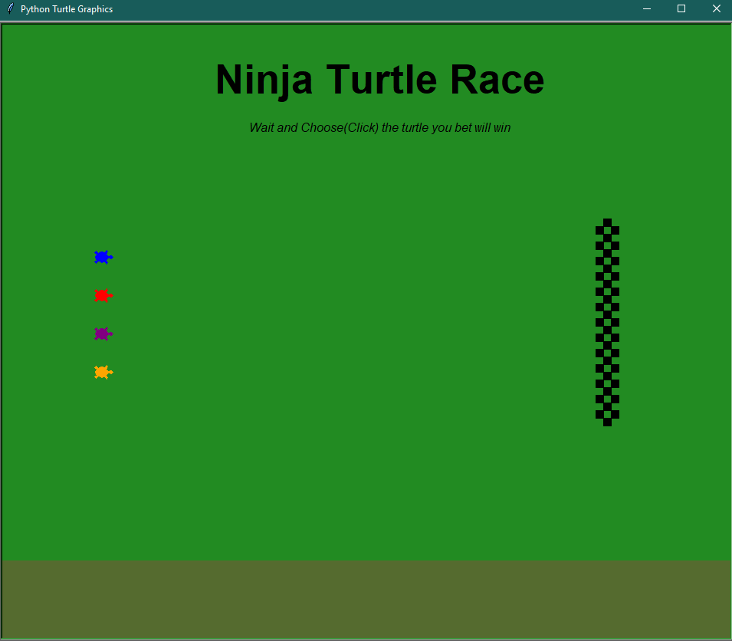
Demo Game

Slide 16

Thank You!

